Slide 1
VDA6.3 Awareness Session

Slide 2
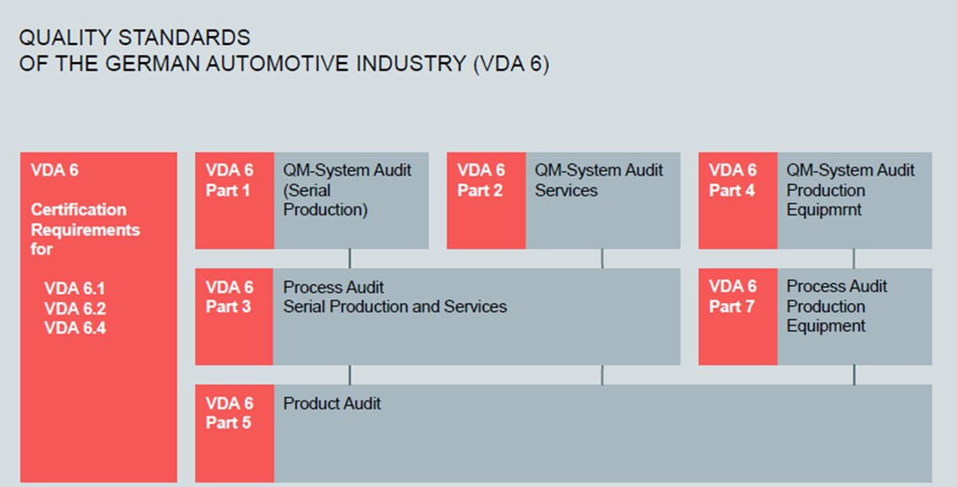
VDA 6.3- Introduction

Slide 3
VDA 6.3- Introduction

Slide 4
VDA 6.3- Introduction
Definition of Process Audit
A process audit is method for impartial analysis and evaluation of the performance of a product development cycle and the effectiveness for the defined product
The goal of the process audit is to check the conformity of the requirements/process step with the specifications. Any deviations that are detected are documented as audit findings and evaluated based on the product risk and /or the process risk. The evaluation must consider what the resulting risks would be if the findings indicates non-compliant products
Area of Application
Process audits can be used internally as well as externally throughout the entire product life cycle.
Using the VDA 6.3 process audit, the processes in the product development process (PEP) can be analyzed and the maturity level and process risk evaluated before SOP

Slide 5
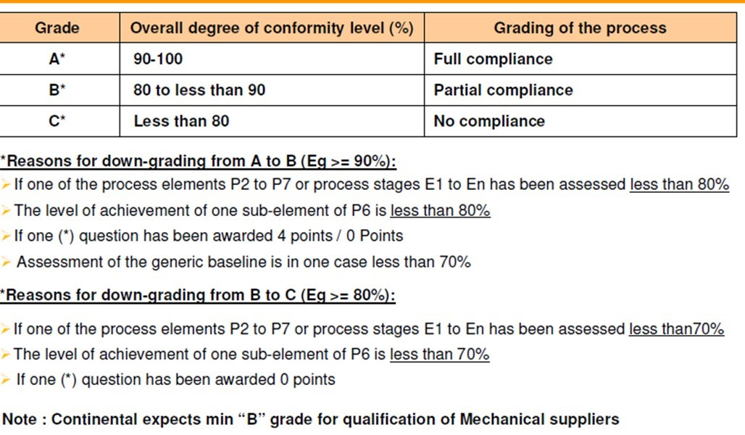
VDA 6.3 – Qualification Criteria

Slide 6
VDA 6.3 - Introduction
Chapters
There are 6 chapters
P1- Potential Analysis
P2- Project Management
P3- Planning of the product- and process development
P4- Carrying out the product- and process development
P5- Supplier Management
P6- Process analysis / Production
P7- Customer Support
Rating Criteria
There are 58 questions, with max. mark of 10, marks are awarded as 0,4,6,8,10.
There are 19 (*) mark questions, which causes down grading if rated less.

Slide 7
VDA 6.3- Audit Scope
Chapters
Note
VDA 6.3 – is applicable through out supply chain, customer may audit supplier for strategic part supplier
Chapter | Condition
P1 | New Supplier Introduction- Potential Analysis
P2, P3, P4 | New Development
P5, P6, P7 | Routing Periodic Audit
P1-P7 | New Site Existing Site+ New Product

Slide 8
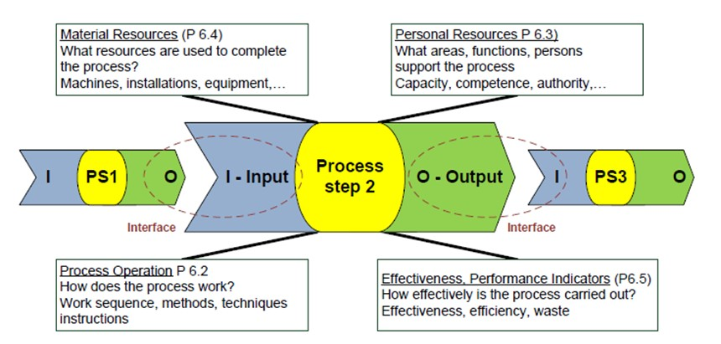
VDA 6.3- Introduction
Identification of Process Risk (Risk Analysis)
In a process audit, the effect of the individual processes on the product is decisive and the assessment must therefore be made from the stand-point of the product risk involved, for this reason, the potential risk within the process must be determined as early as the preparations for the audit, so that they may be assessed adequately in the process audit itself- for the same, each process is mapped into a turtle diagram
Unit Risk

Slide 9
Turtle Diagram
Steps In creating Turtle Diagram
Define Input
Identify Process/method to convert input to output
Identify personal resources (competency of people required to perform the task)
Identify facilities /resources to execute process – Hardware
Decide indicators to monitor effectiveness of process
Define output
4
3
1
6
2
5

Slide 10
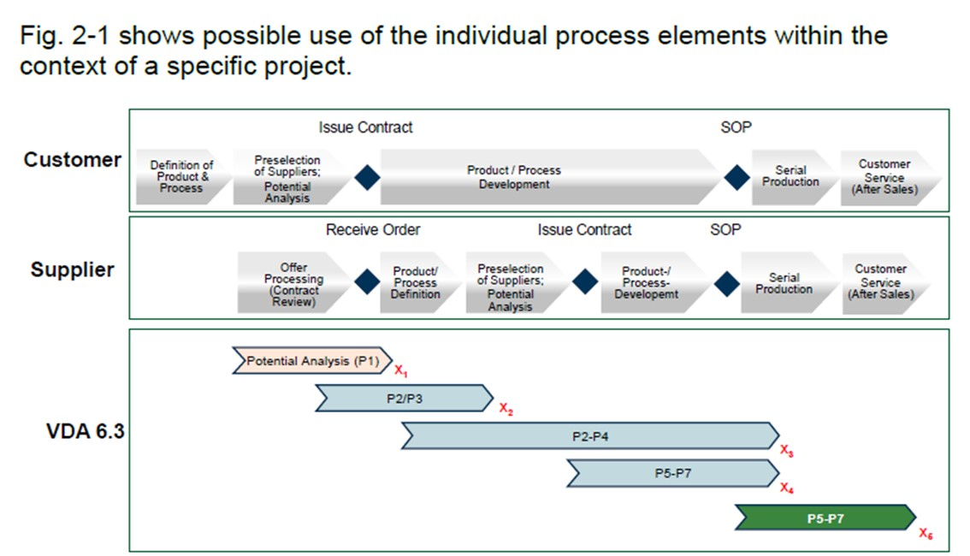
Process Audit- Area of Application

Slide 11
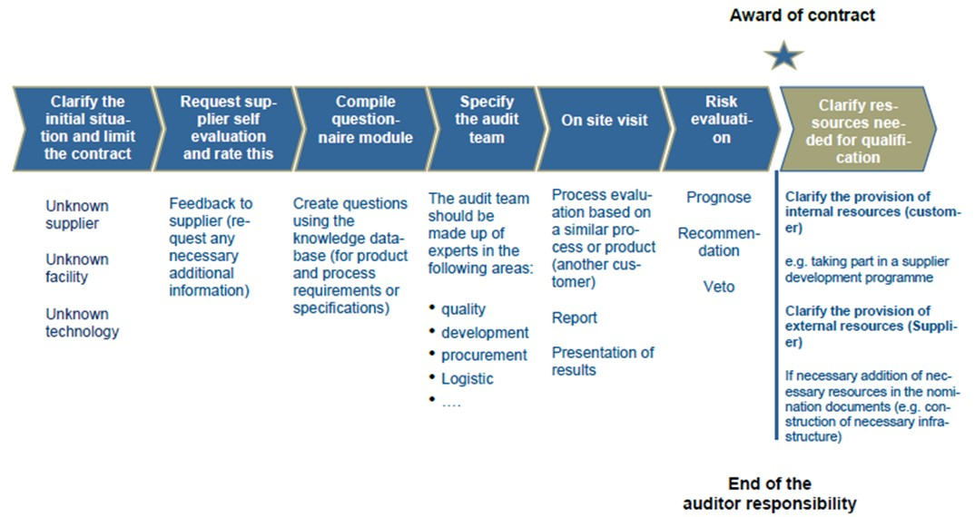
P1- Potential Analysis- Operational Sequence
The evaluation questions in the P1 analysis are selected from the process elements P2 – P7

Slide 12
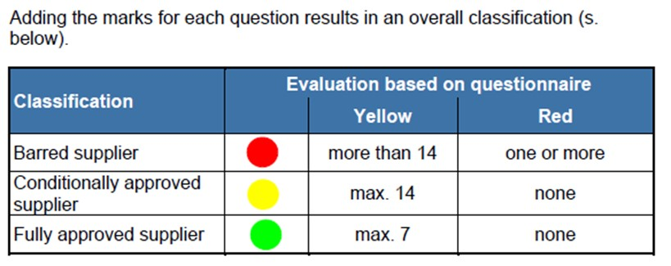
P1- Potential Analysis- Evaluation

Slide 13
P2- Project Management

Slide 14
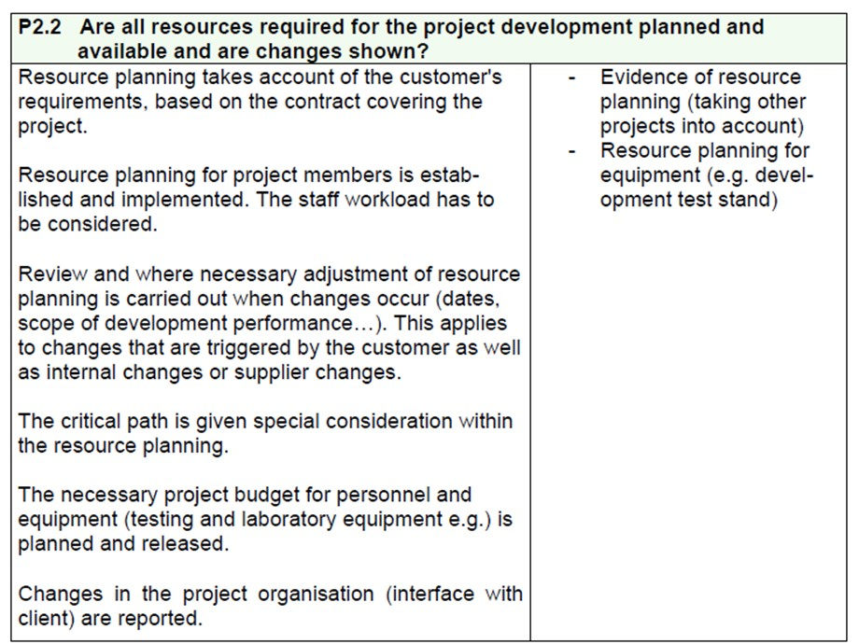
P2- Project Management

Slide 15
P2- Project Management

Slide 16
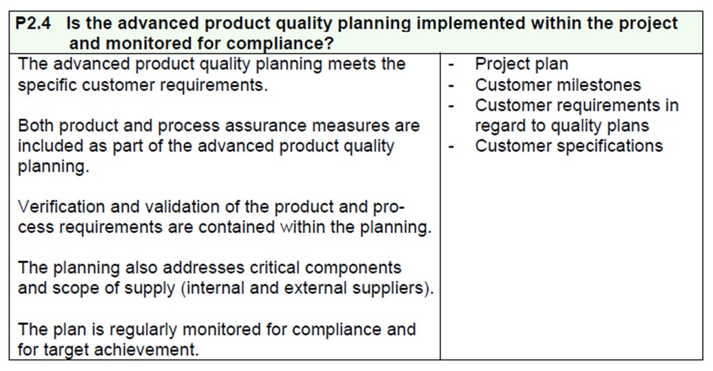
P2- Project Management

Slide 17
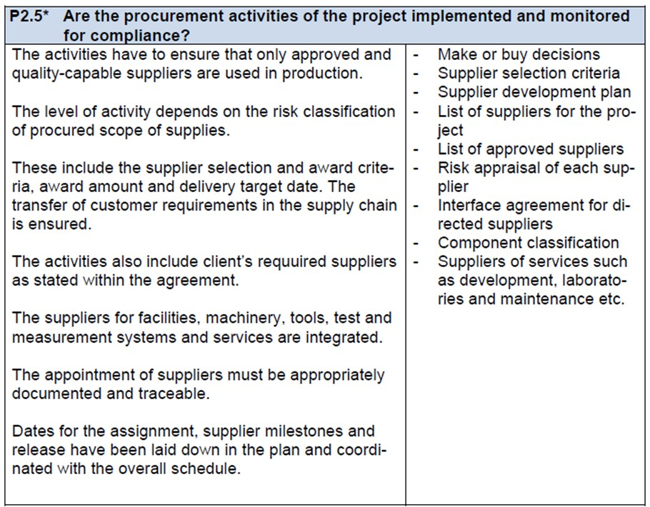
P2- Project Management

Slide 18
P2- Project Management

Slide 19
P2- Project Management

Slide 20
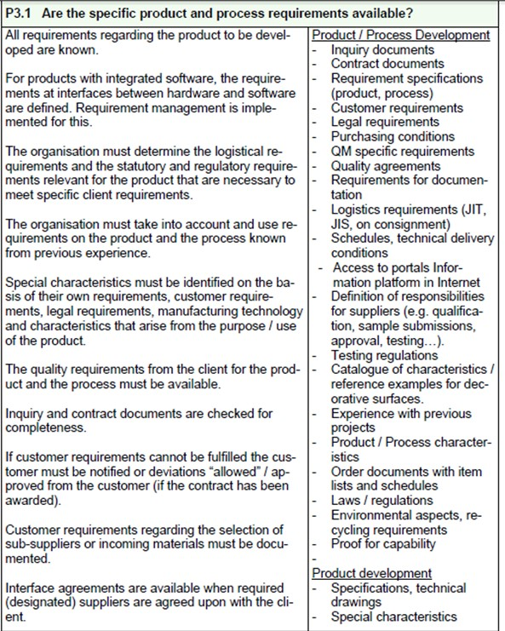
P3- Planning the Product & Process Development

Slide 21
P3- Planning the Product & Process Development

Slide 22
P3- Planning the Product & Process Development

Slide 23
P3- Planning the Product & Process Development

Slide 24
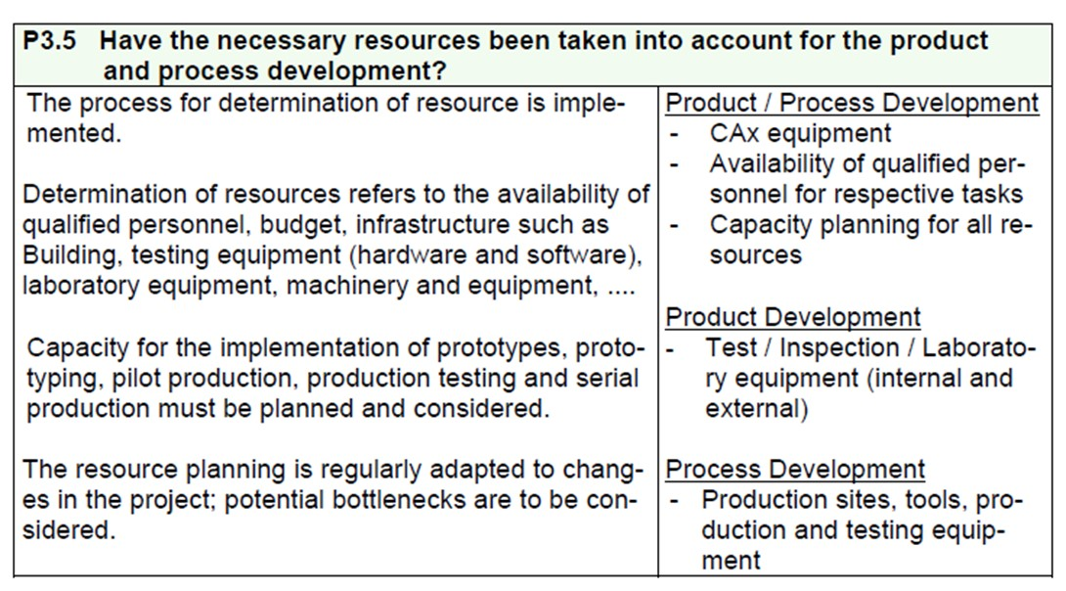
P3- Planning the Product & Process Development

Slide 25
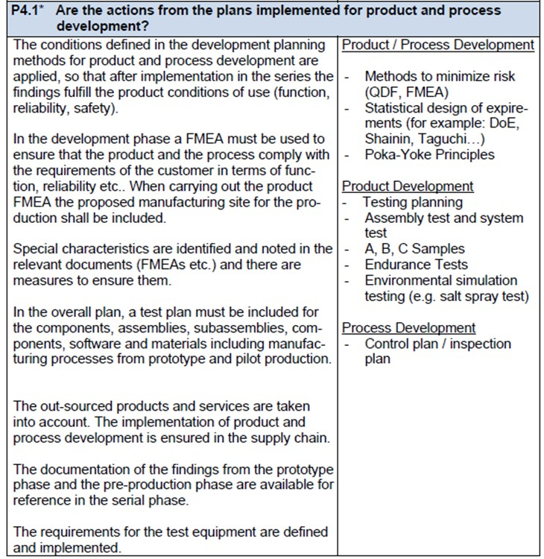
P4- Implementation of Product & Process Development

Slide 26
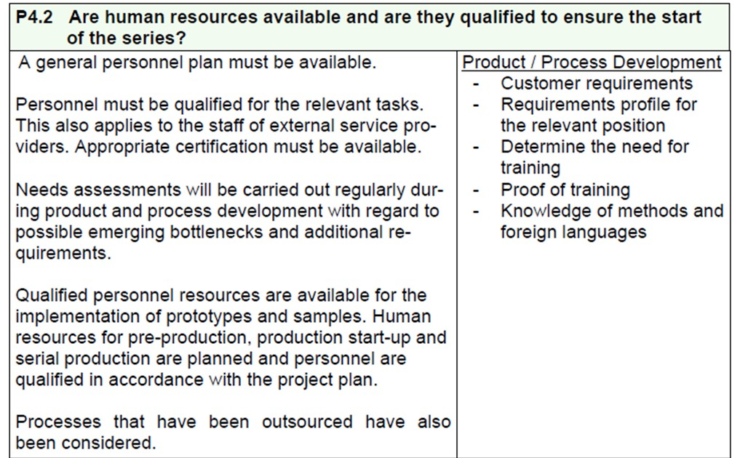
P4- Implementation of Product & Process Development

Slide 27
P4- Implementation of Product & Process Development

Slide 28
P4- Implementation of Product & Process Development

Slide 29
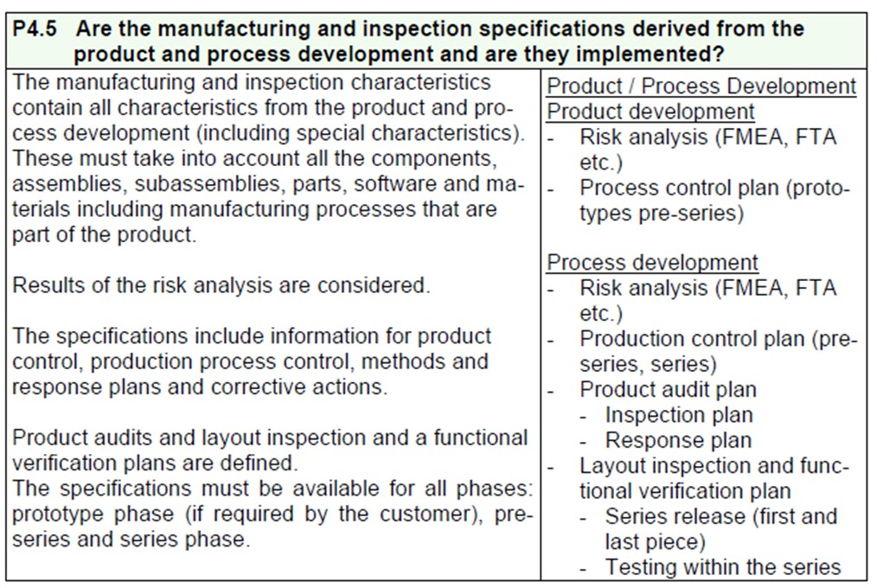
P4- Implementation of Product & Process Development

Slide 30
P4- Implementation of Product & Process Development

Slide 31
P4- Implementation of Product & Process Development

Slide 32
P5- Supplier Management

Slide 33
P5- Supplier Management

Slide 34
P5- Supplier Management

Slide 35
P5- Supplier Management

Slide 36
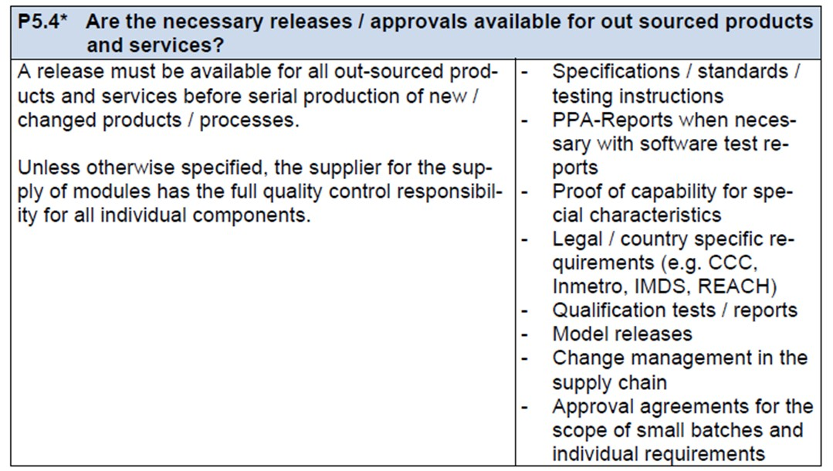
P5- Supplier Management

Slide 37
P5- Supplier Management

Slide 38
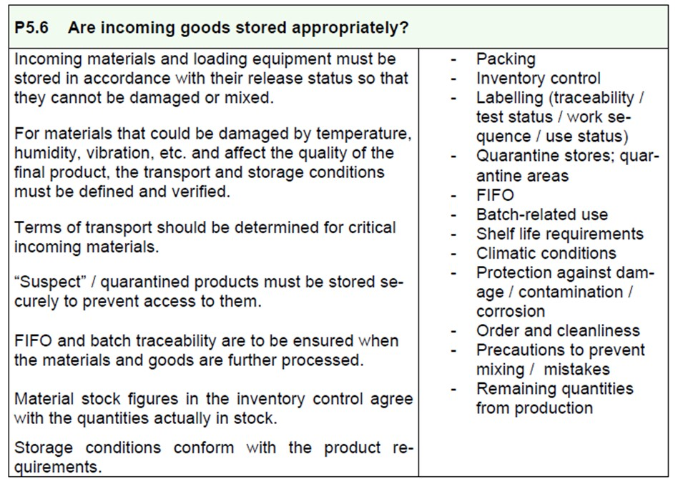
P5- Supplier Management

Slide 39
P5- Supplier Management

Slide 40
P6- Production Control
6.1 What goes into the Process- Process Input
6.1.1- Has the project been transferred from development to serial production and is a reliable start guaranteed?
6.1.2- Are the necessary quantities/production batch sizes of incoming materials available at the agreed upon time and at the correct storage/work-station?
6.1.3- Are incoming materials stored appropriately and are the means of transport means/packing facilities suitable for the special characteristics of the incoming materials?
6.1.4- Are the necessary identifications/records/releases available and allocated appropriately to the incoming materials?
6.1.5- Are changes to the product or process in the course of serial production tracked and documented?

Slide 41
P6- Production Control
6.2 Are all Production Processes Controlled? (Process Sequence)
6.2.1- Are the requirements of the control plan complete and have they been effectively implemented?
6.2.2*- Is there a repeat release of manufacturing processes?
6.2.3*- Are special characteristics managed in the production?
6.2.4*- Are non-approved and /or defective parts managed?
6.2.5- Is the flow of materials and parts secured against mixing/wrong items?

Slide 42
P6- Production Control
6.3 What functions support the process? (Personnel Resources)
6.3.1*- Are the employees able to fulfil their given tasks?
6.3.2- Do the employees know their responsibilities and authority in the monitoring of the product and process quality?
6.3.3- Are the necessary personnel resources available?

Slide 43
P6- Production Control
6.4 What means are used to implement the process? ( Material Resources)
6.4.1*- Can the product-specific requirements from the customer be met with the manufacturing equipment?
6.4.2- Is the maintenance of the manufacturing equipment and tools controlled?
6.4.3*- Can the quality requirements be effectively monitored with the measurement and testing facilities in use?
6.4.4- Are the work and inspection stations appropriate for the needs?
6.4.5- Are tools, equipment and testing equipment stored properly?

Slide 44
P6- Production Control
6.5 How effective is the process being carried out? (effectiveness)
6.5.1- Are there targets set for the manufacturing process?
6.5.2- Is quality and process data collected in a way that allows analysis?
6.5.3- In the case of deviations from product and process requirements, are the causes analysed and the corrective actions checked for effectiveness?
6.5.4- Are processes and products audited regularly?

Slide 45
P6- Production Control
6.6 What should the process produce? (Output)
6.6.1 – Do the quantities/production batch sizes match needs and are they systematically directed to the next process step?
6.6.2- Are products/components stored in an appropriate manner and are transport facilities/packing arrangements suitable for the special charc. Of the products?
6.6.3 – Are the necessary records/releases documented?
6.6.4*- Are the customer requirements met at the delivery of the final products?

Slide 46
P7- Customer Support

Slide 47
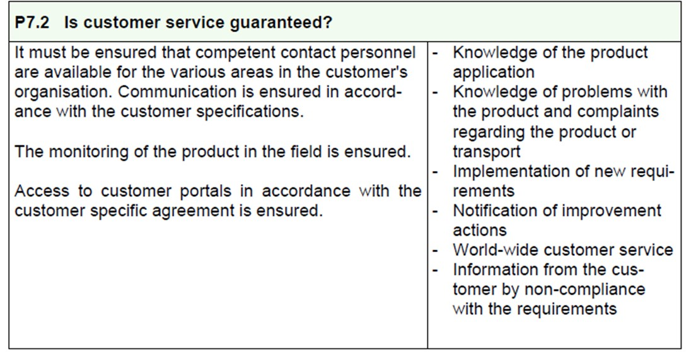
P7- Customer Support

Slide 48
P7- Customer Support

Slide 49
P7- Customer Support

Slide 50
P7- Customer Support

Slide 51
End of Presentation

